Slide 1
Database provides organized and persistent storage for your data
choose between different database types, we would need to understand
Availability
Durability
RTO
RPO
Availability -
Will i be able to access my data now and when i need it?
percentage of time an application provides the opertaions expected of it
Durability -
Will my data available after 10 or 100 years?
RPO(data point objective) - Maximum acceptable period of data loss
RTO(data time objective) - Maximum acceptable downtime

Slide 2
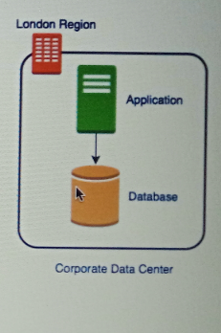
Challenges :
1. if your data base goes down if the data center crashes or the server storage fails
2. You will lose data if the database crashes

Slide 3
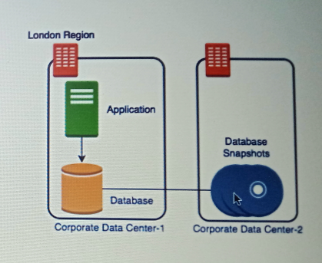
Database - Snapshots
1. if your data base goes down if the data center crashes or the server storage fails
2. (Partially Solved)You will lose data if the database crashes
- you lose 1 hour data
3. Database will be slow when taking the snapshot

Slide 4
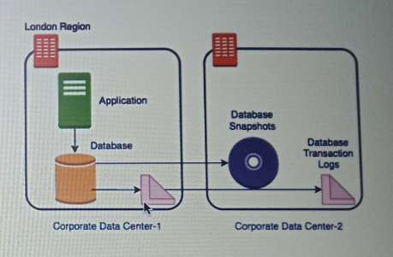
Database – Transactional Logs
1. if your data base goes down if the data center crashes or the server storage fails
2. (Solved)You will lose data if the database crashes
- You setup data from latest snapshot & apply transactional logs
3. Database will be slow when taking the snapshot

Slide 5
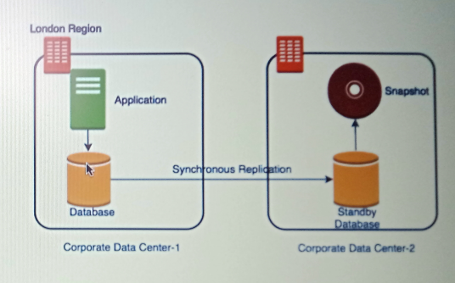
Database – Add a standby
(SOLVED )if your data base goes down if the data center crashes or the server storage fails
- Switch to database standby
2. (Solved)You will lose data if the database crashes
3. (Solved) Database will be slow when taking the snapshot
Take snapshots from standby
Application connecting to master will get good performance always

Slide 6
Amazon RDS (Relational Database Service)
Do you want to manage the setup ,backup, scaling, replication and patching of your relational database?
or do you want to use a managed service?
Amazon RDS is a managed relational database service for OLTP use case
OLTP (Online Transactional Processing) is a type of data processing that executes transaction-focused tasks. It involves inserting, deleting, or updating small quantities of database data.
OLTP Example :
Online banking, Online airline ticket booking, sending a text message, add a book to the shopping cart
Supports :
Amazon Aurora - customization of two databases(MySQL + PostgresSQL)
MySQL
PostgresSQL
MariaDB (Enhanced MYSQL)
Oracle Database
Microsoft SQL Database

Slide 7
Connecting from the MySQL client
host=
databaseidentifier=mysql-db-identifier
user=
password=
databasename=mysqlDB
Command to install MySQL in EC2 instance
sudo yum install mysql
mysql --host=HOSTNAME --user=admin --password mysqlDB
mysql --host=mydatabase-identifier.ca1u3y7nrekc.us-east-1.rds.amazonaws.com --user=admin --password mydatabase-identifier
Reference URL : https://docs.aws.amazon.com/AmazonRDS/latest/UserGuide/USER_ConnectToInstance.html
create table users ( id integer, username varchar(30) );
insert into users values (1,"XYZ");
Running MySQL Databases on AWS EC2
https://towardsdatascience.com/running-mysql-databases-on-aws-ec2-a-tutorial-for-beginners-4301faa0c247

Slide 8
Amazon Dynamo DB
Fast, Scalable, distributed for any scale automatically
Flexible NoSQL key-value & document database (schemaless)
Single digit milliseconds responses for million of TPS (Transaction per second )
Do not worry about scaling , availability or durability
Automatically partitions data as it grows
Maintains 3 replicas within same region
No need to provision a database
Create a table and configure read and write capacity(RCU and WCU)
Automatically scales to meet your RCU and WCU
Use Cases : mobile, web, gaming, ad tech, IoT, and other applications that need low-latency data access at any scale

Slide 9
Data Types
DynamoDB supports many different data types for attributes within a table. They can be categorized as follows:
Scalar Types – A scalar type can represent exactly one value. The scalar types are number, string, binary, Boolean, and null.
Document Types – A document type can represent a complex structure with nested attributes, such as you would find in a JSON document. The document types are list and map.
Set Types – A set type can represent multiple scalar values. The set types are string set, number set, and binary set.
Ref URL for examples : https://docs.aws.amazon.com/amazondynamodb/latest/APIReference/API_AttributeValue.html

Slide 10
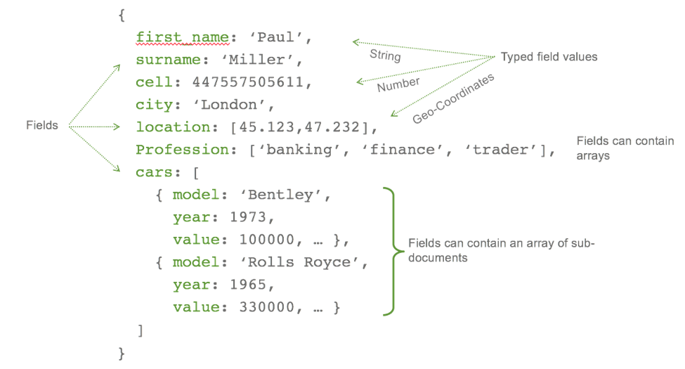
DynamoDB Table Structure
Hierarchy : Tables -> items -> attribute(key value pair)
Mandatory primary key
Other than primark key,tables are schema less
No need to define the other attributes or types
Each item in a table can have distinct attributes
Max 400KB per item in table
Use s3 for large objects and DynamoDB for smaller objects
Dynamo Tables are region specific
If the users are in multiple region, mark the table as Global Table

Slide 11
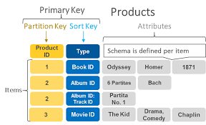
DynamoDB-Partition Key
DynamoDB supports two types of primary keys:
Partition key: A simple primary key, composed of one attribute known as the partition key. Attributes in DynamoDB are similar in many ways to fields or columns in other database systems.
Partition key and sort key: Referred to as a composite primary key, this type of key is composed of two attributes. The first attribute is the partition key, and the second attribute is the sort key. Following is an example.

